Slide 1
Distributed Systems
Distributed
File Systems
Chapter 11

Slide 2
Course/Slides Credits
Note: all course presentations are based on those developed by Andrew S. Tanenbaum and Maarten van Steen. They accompany their "Distributed Systems: Principles and Paradigms" textbook (1st & 2nd editions).
http://www.prenhall.com/divisions/esm/app/author_tanenbaum/custom/dist_sys_1e/index.html
And additions made by Paul Barry in course CW046-4: Distributed Systems
http://glasnost.itcarlow.ie/~barryp/net4.html

Slide 3
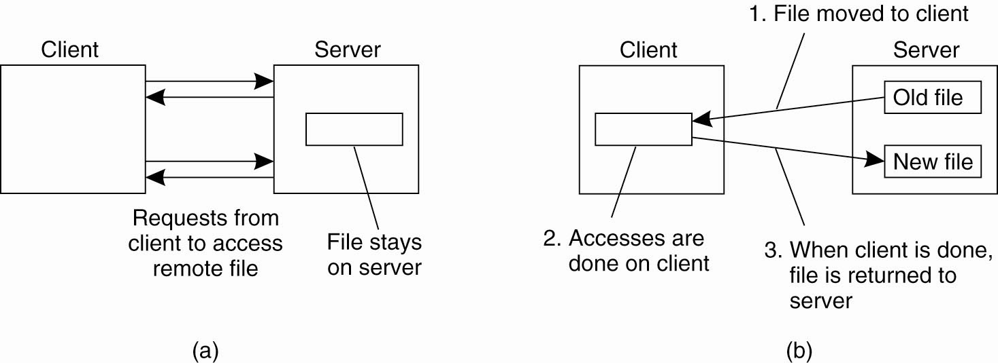
Client-Server Architectures (1)
(a) The remote access model
(b) The upload/download model

Slide 4
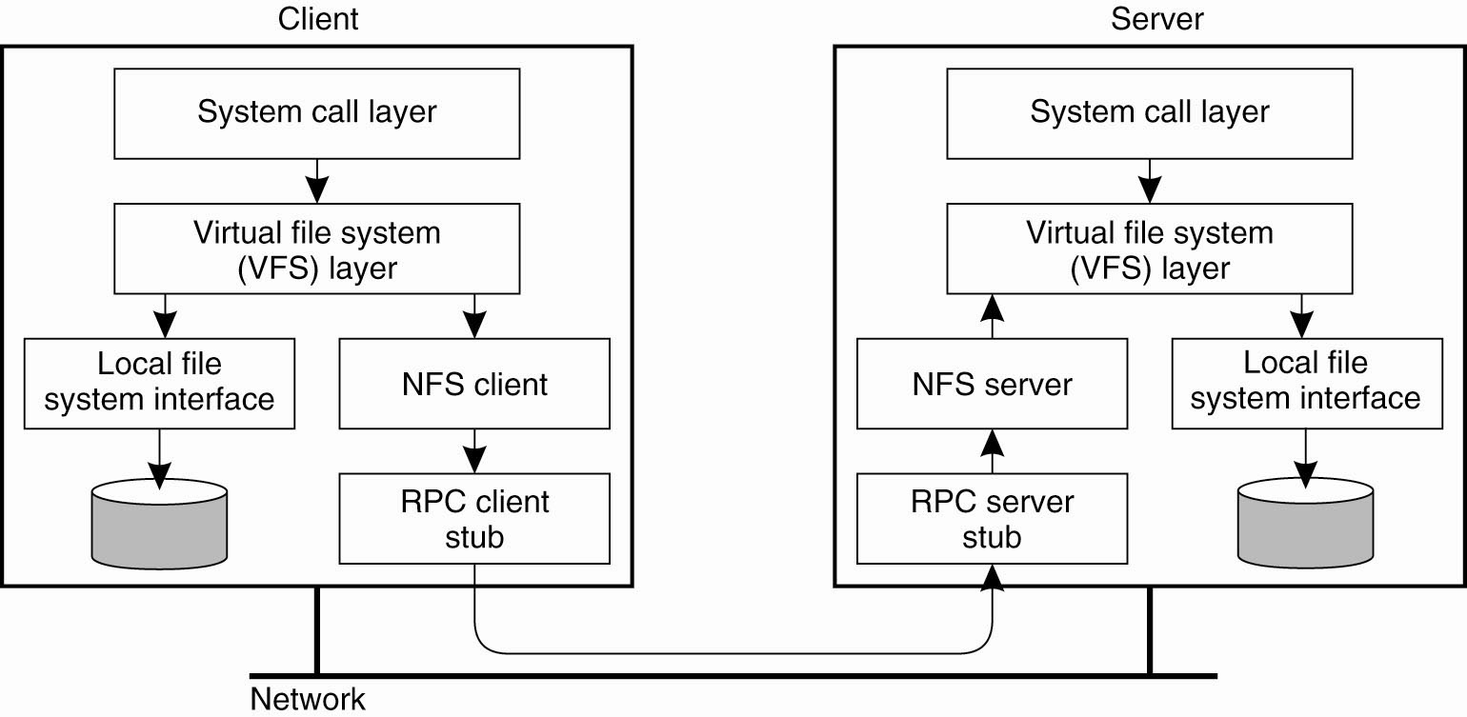
Client-Server Architectures (2)
The basic NFS architecture for UNIX systems

Slide 5
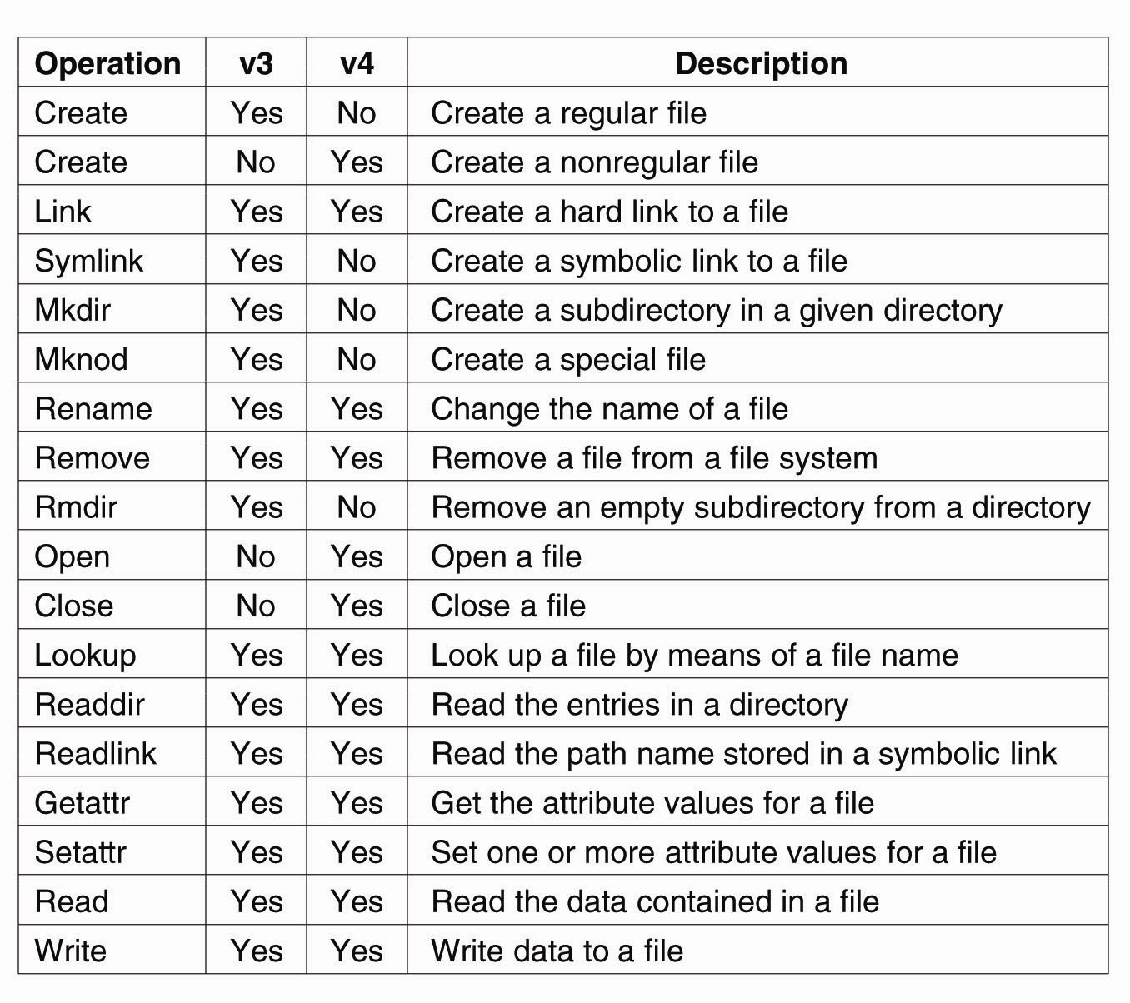
File System Model (1)
An incomplete list of file system operations supported by NFS

Slide 6
File System Model (2)
An incomplete list of file system operations
supported by NFS

Slide 7
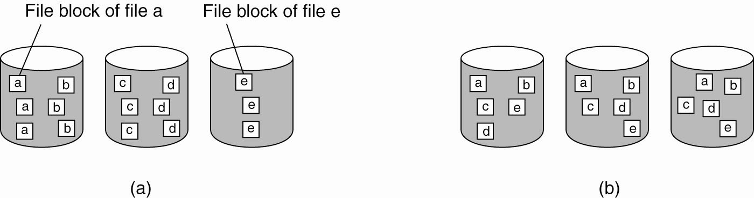
Cluster-Based Distributed File Systems (1)
The difference between (a) distributing whole files across several servers and
(b) striping files for parallel access

Slide 8
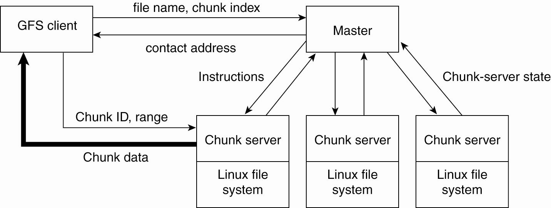
Cluster-Based Distributed File Systems (2)
The organization of a Google cluster of servers

Slide 9
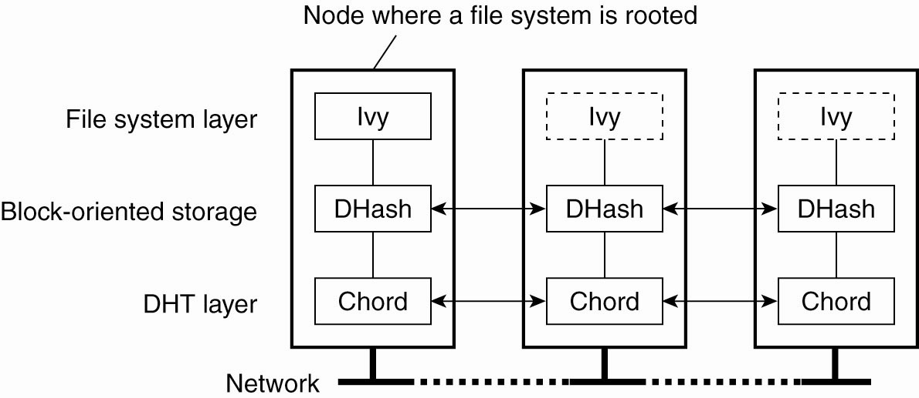
Symmetric Architectures
The organization of the Ivy distributed file system

Slide 10
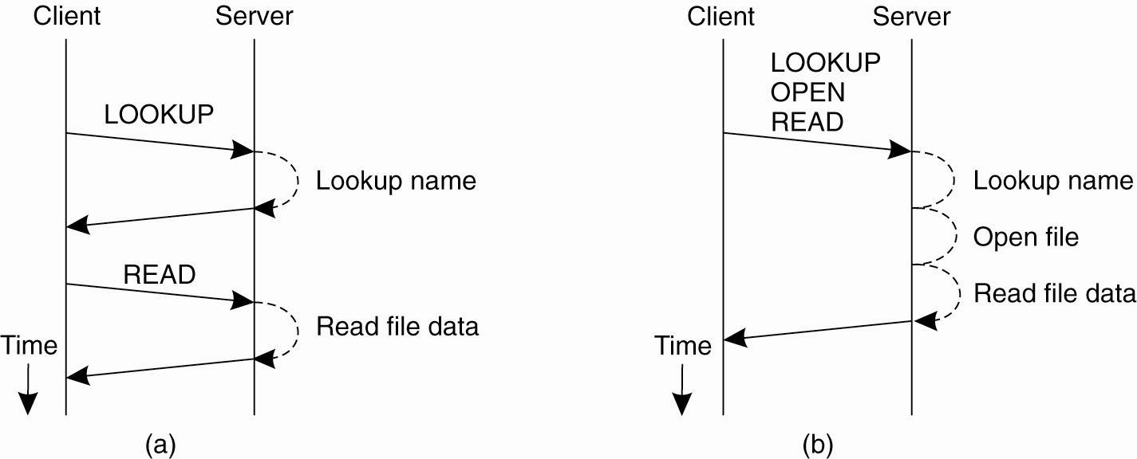
Remote Procedure Calls in NFS
(a) Reading data from a file in NFS version 3.
(b) Reading data using compound procedure in version 4.

Slide 11
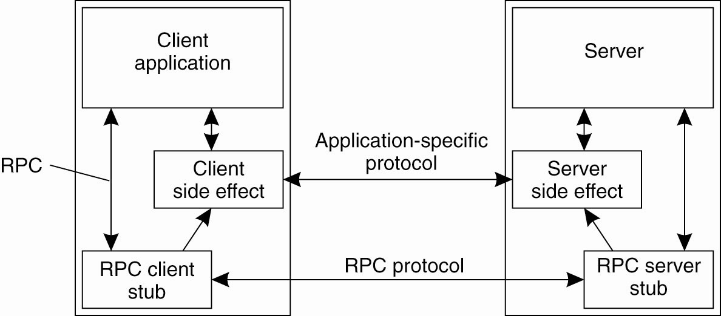
The RPC2 Subsystem (1)
Side effects in Coda’s RPC2 system

Slide 12
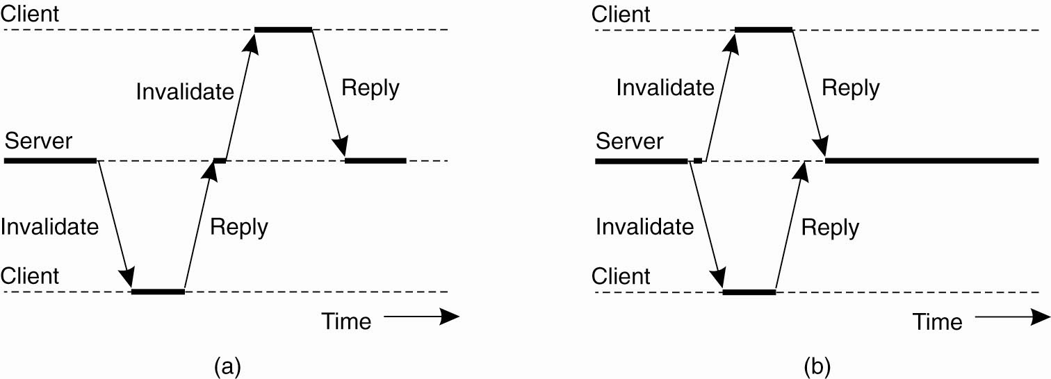
The RPC2 Subsystem (2)
(a) Sending an invalidation message one at a time. (b) Sending invalidation messages in parallel.

Slide 13
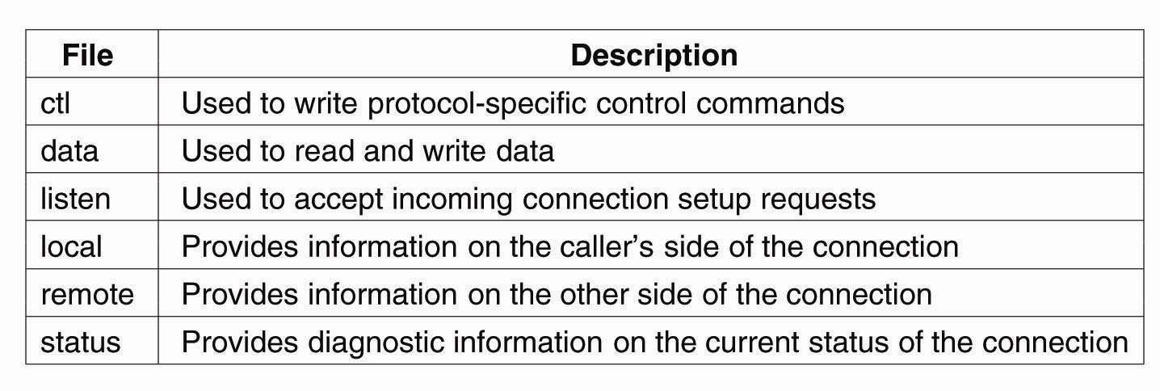
File-Oriented Communication in Plan 9
Files associated with a single TCP connection in Plan 9

Slide 14
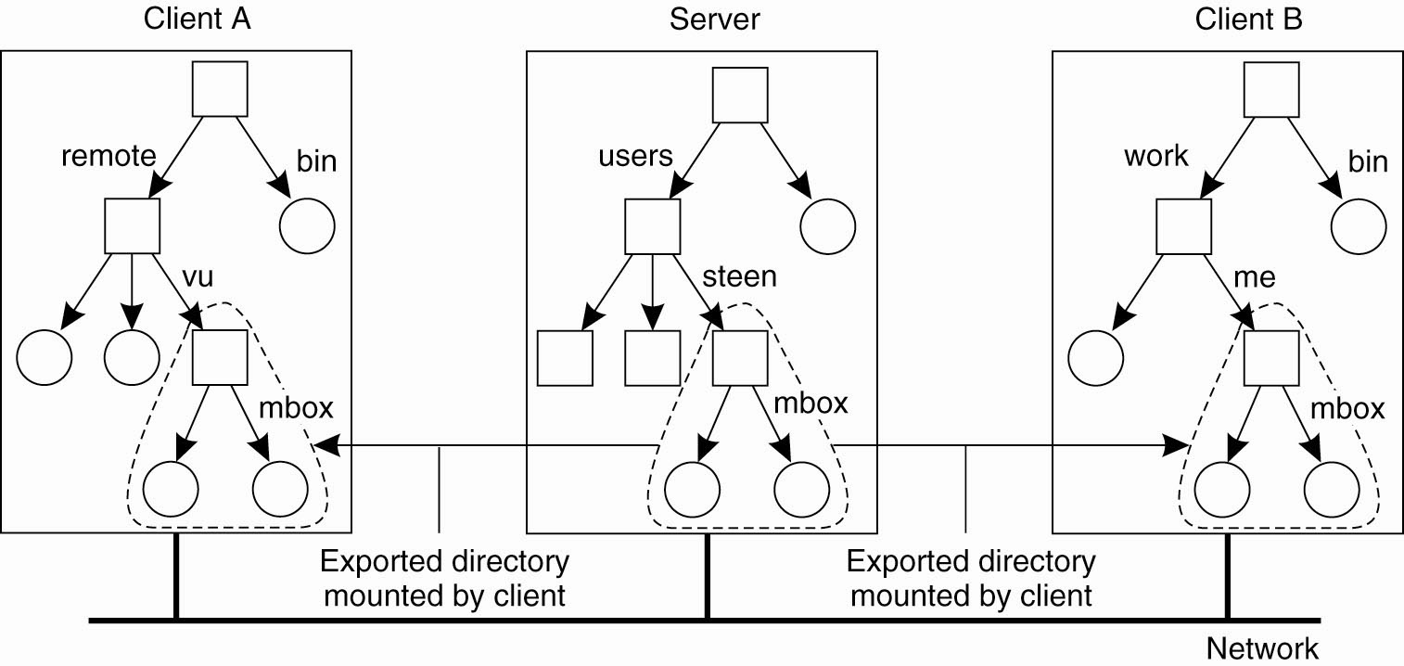
Naming in NFS (1)
Mounting (part of) a remote file system in NFS

Slide 15
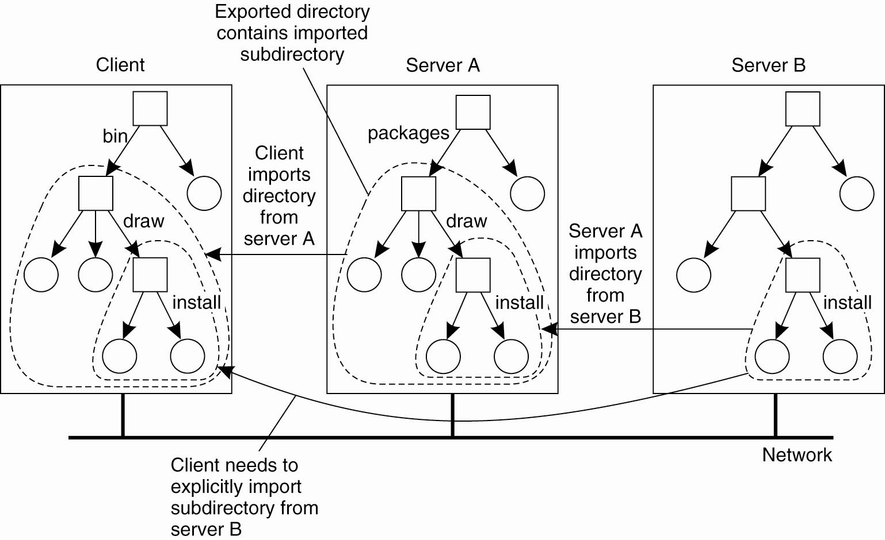
Naming in NFS (2)
Mounting nested directories from
multiple servers in NFS

Slide 16
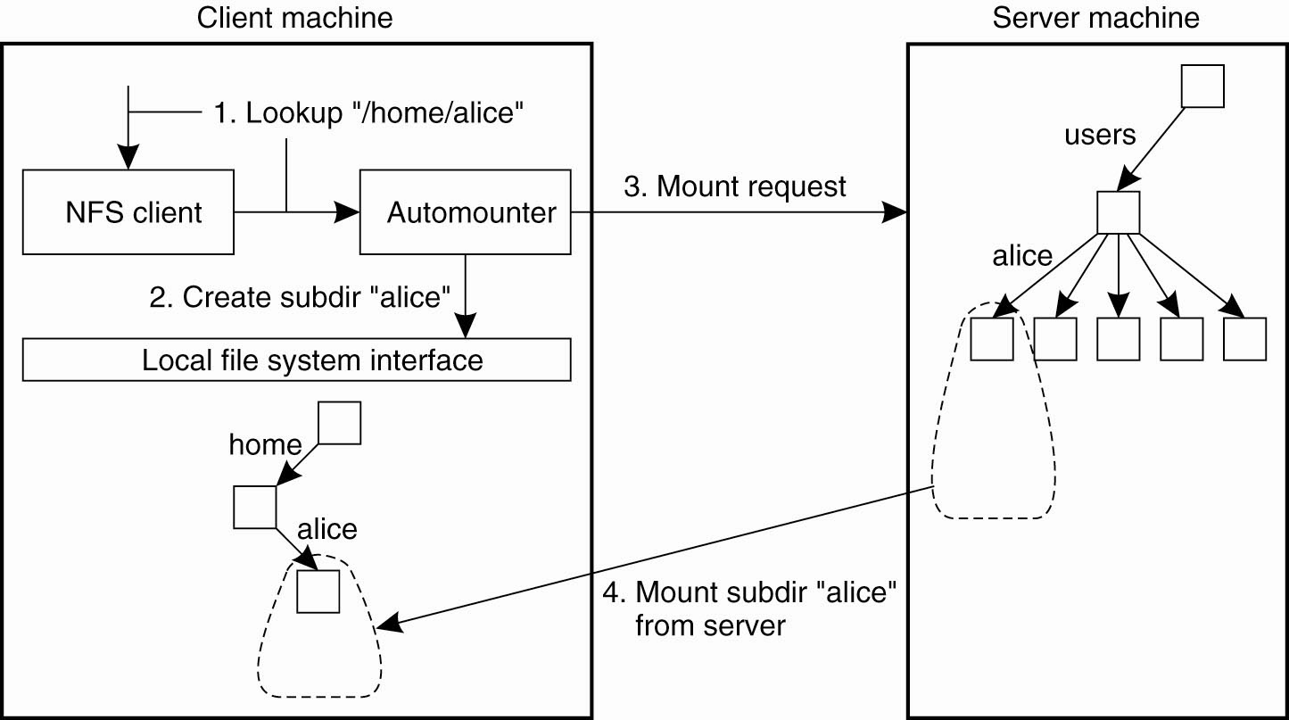
Automounting (1)
A simple automounter for NFS

Slide 17
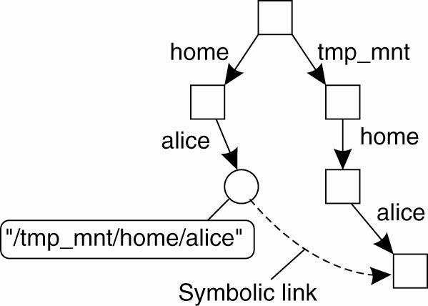
Automounting (2)
Using symbolic links with automounting

Slide 18
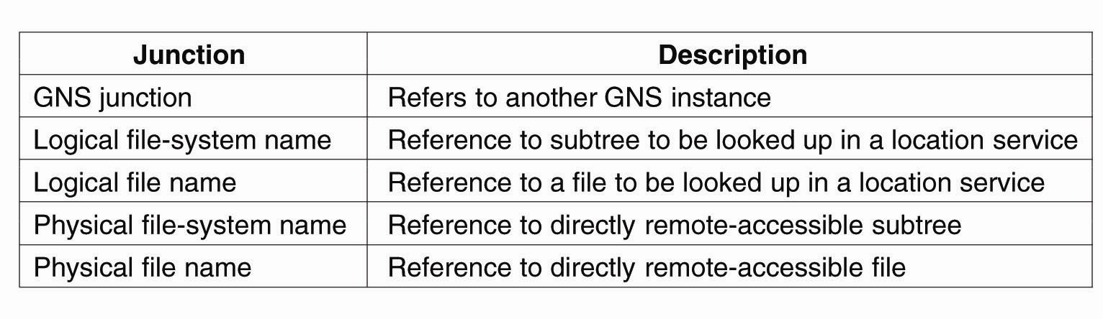
Constructing a Global Name Space
Junctions in GNS

Slide 19
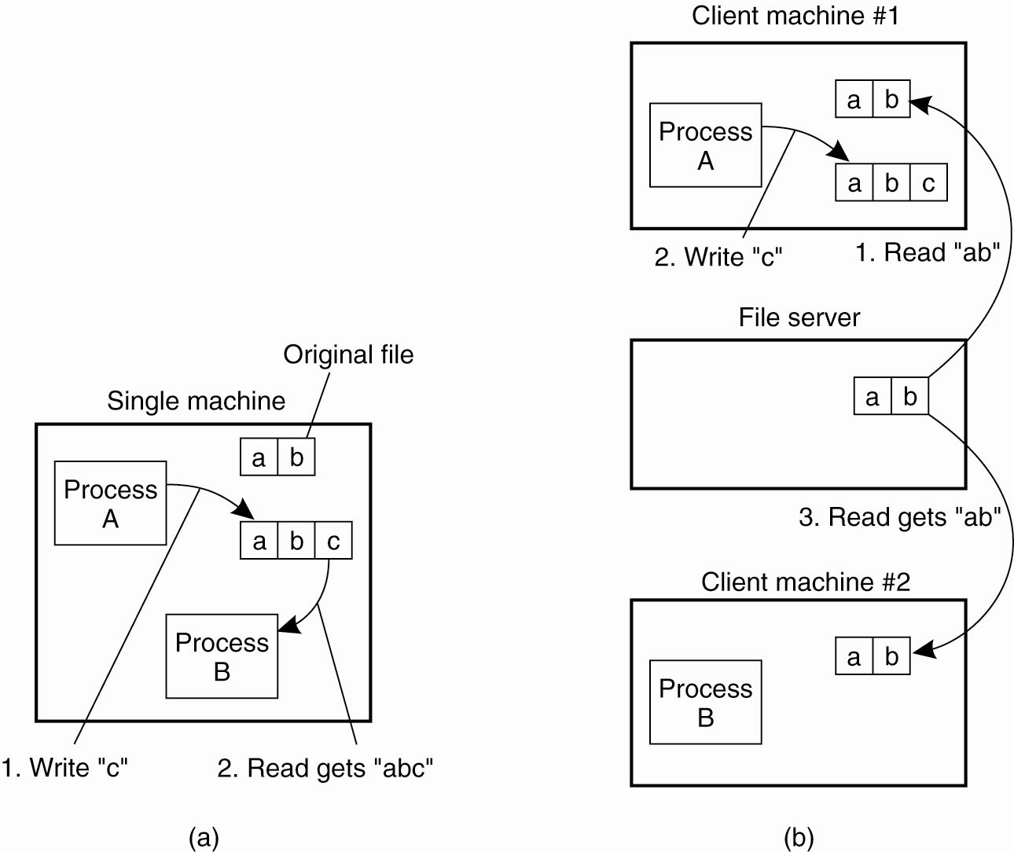
Semantics of File Sharing (1)
(a) On a single processor, when
a read follows a write, the value returned by the read is the value just written.

Slide 20
Semantics of File Sharing (2)
(b) In a distributed system with caching, obsolete values may be returned.

Slide 21
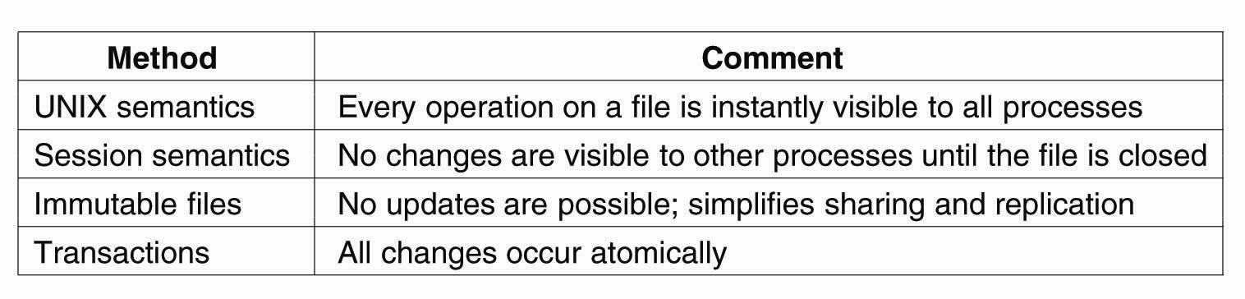
Semantics of File Sharing (3)
Four ways of dealing with the
shared files in a distributed system

Slide 22
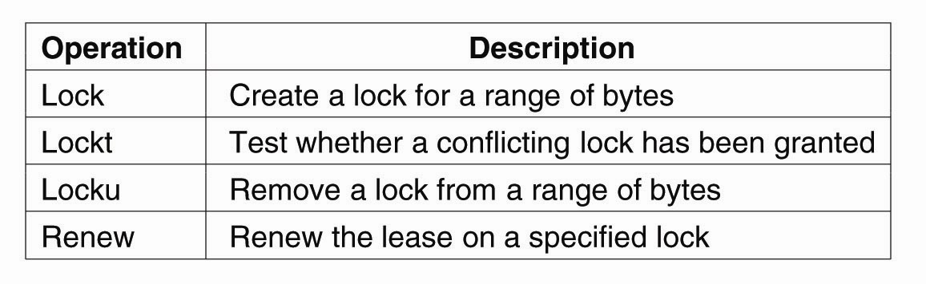
File Locking (1)
NFSv4 operations related to file locking

Slide 23
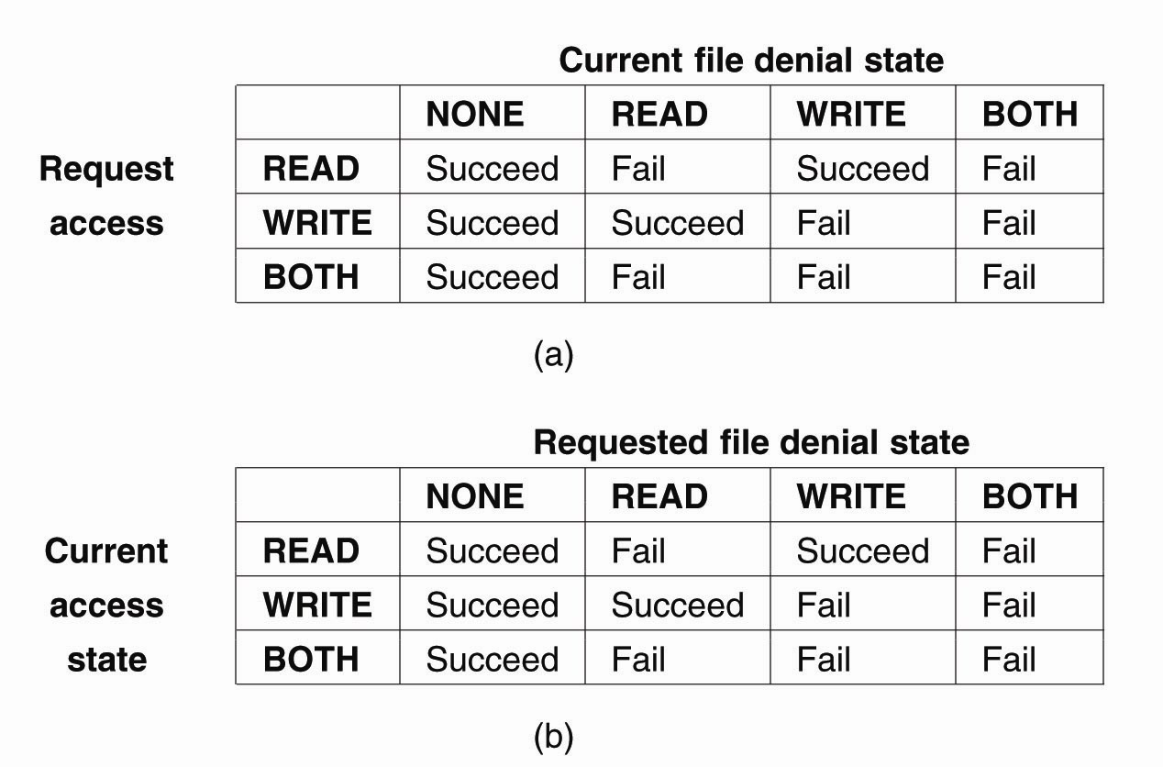
File Locking (2)
The result of an open operation with share reservations in NFS.
(a) When the client requests shared access given the current denial state.

Slide 24
File Locking (3)
The result of an open operation with share reservations in NFS.
(b) When the client requests a denial state given the current file access state.

Slide 25
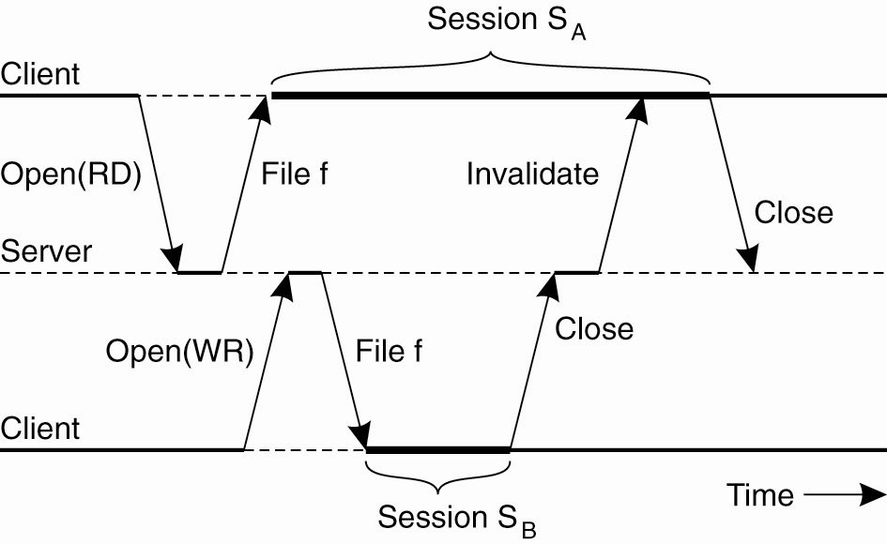
Sharing Files in Coda
The transactional behavior in sharing files in Coda

Slide 26
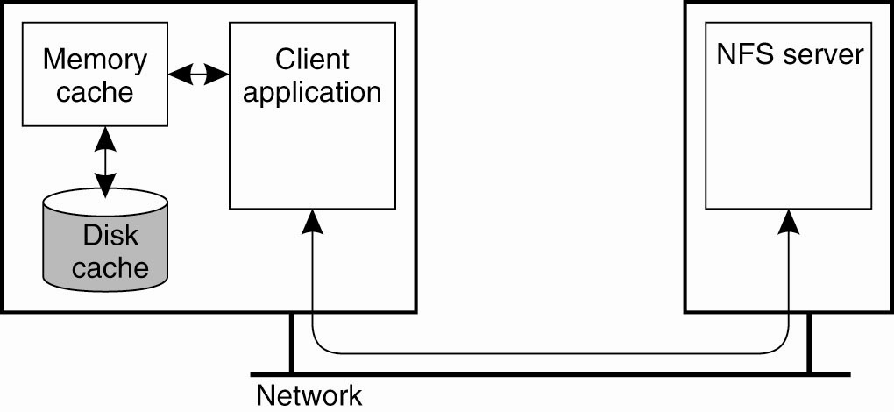
Client-Side Caching (1)
Client-side caching in NFS

Slide 27
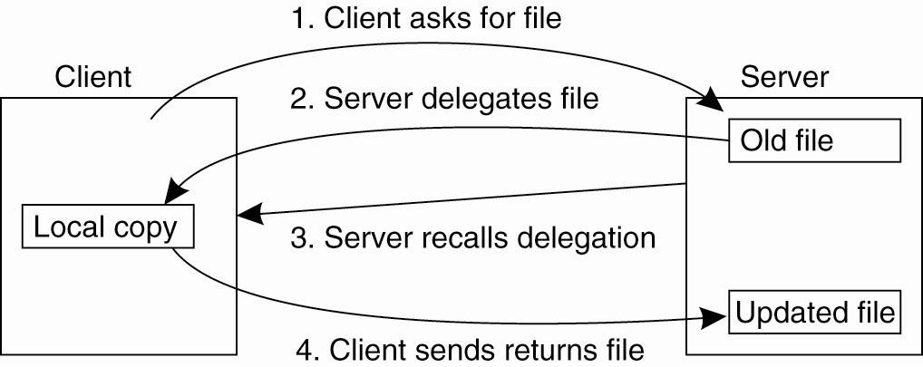
Client-Side Caching (2)
Using the NFSv4 callback mechanism
to recall file delegation

Slide 28
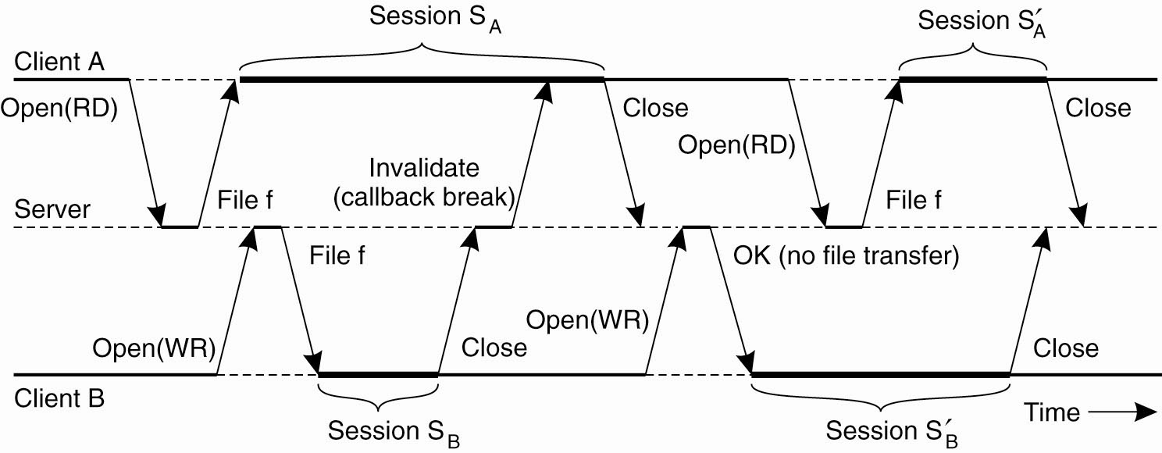
Client-Side Caching in Coda
The use of local copies when
opening a session in Coda

Slide 29
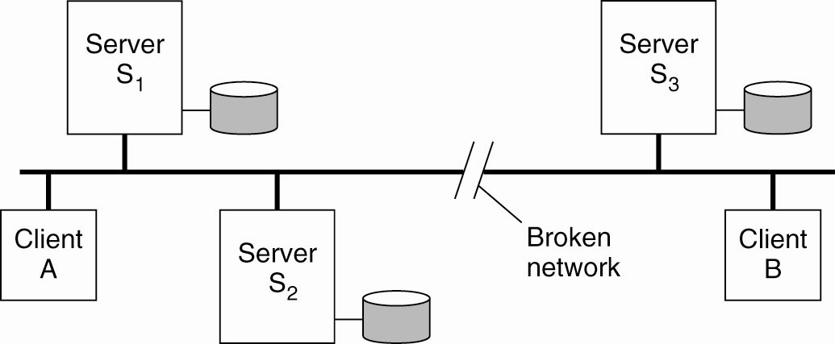
Server Replication in Coda
Two clients with a different
AVSG for the same replicated file

Slide 30
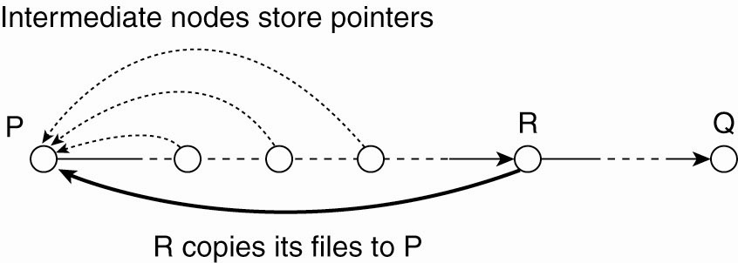
Structured Peer-to-Peer Systems
Balancing load in a peer-to-peer
system by replication

Slide 31
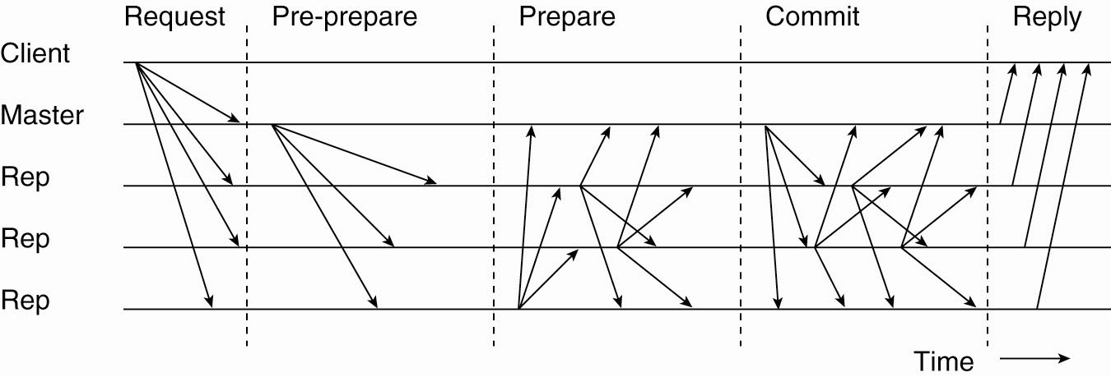
Handling Byzantine Failures
The different phases in Byzantine fault tolerance

Slide 32
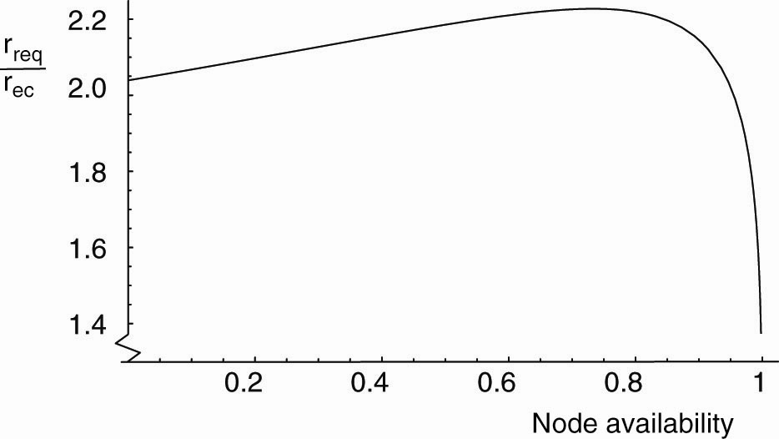
High Availability in Peer-to-Peer Systems
The ratio r_{rep} /r_{ec} as a function of node availability a

Slide 33
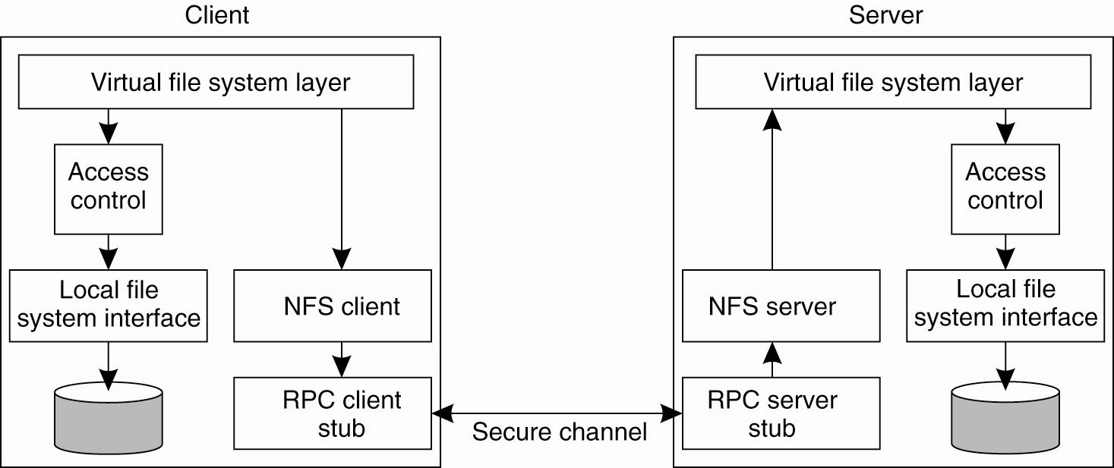
Security in NFS
The NFS security architecture

Slide 34
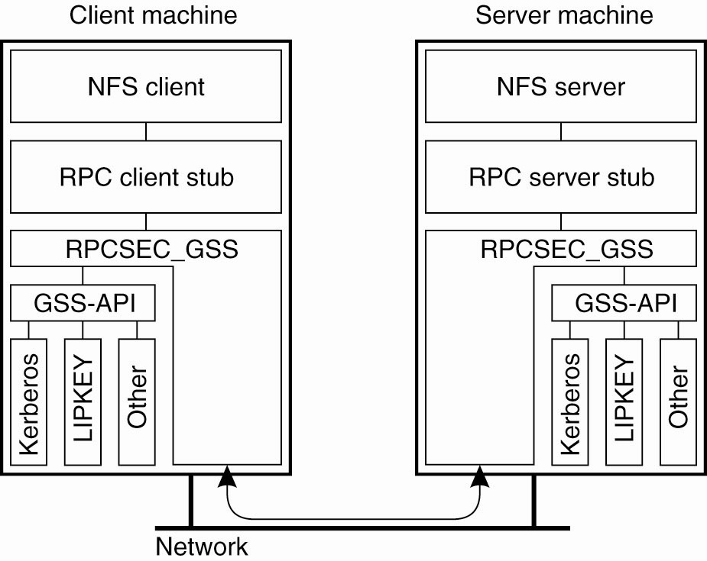
Secure RPCs
Secure RPC in NFSv4

Slide 35
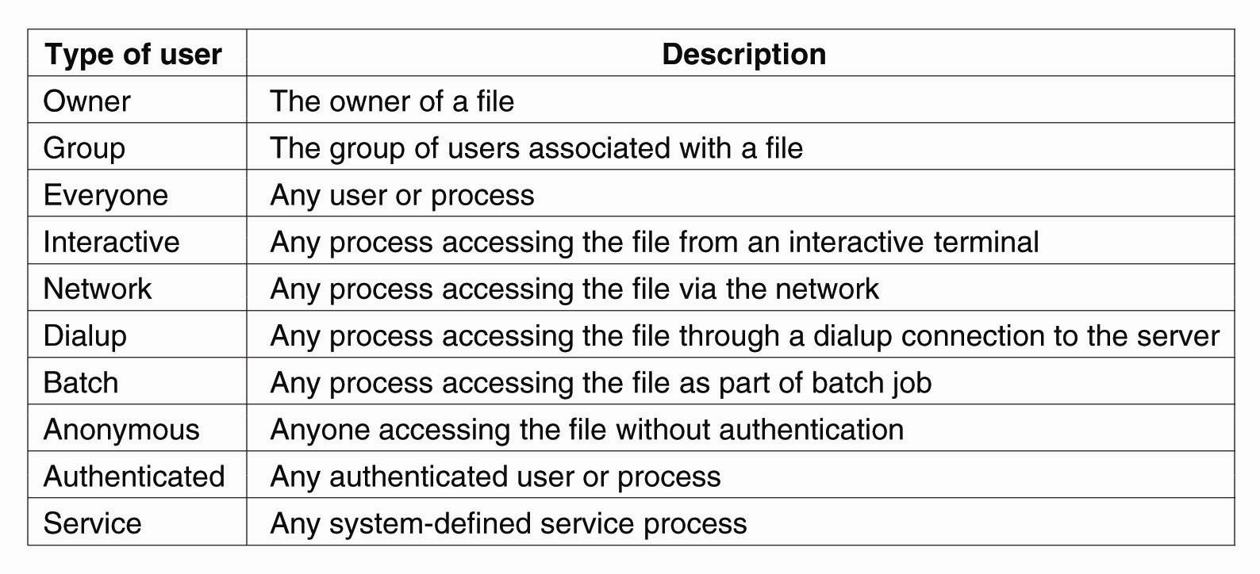
Access Control
The various kinds of users and processes distinguished by NFS with respect to access control

Slide 36
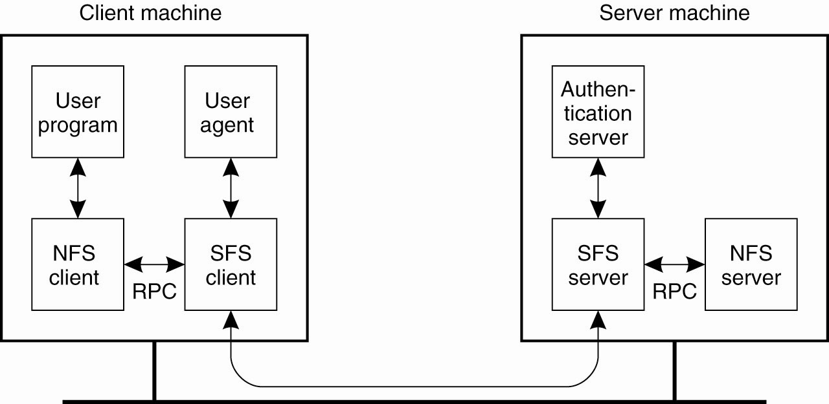
Decentralized Authentication (1)
The organization of SFS

Slide 37
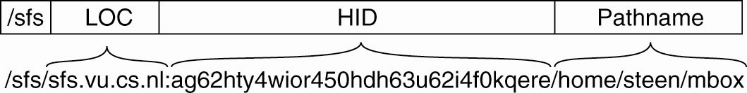
Decentralized Authentication (2)
A self-certifying pathname in SFS

Slide 38
Secure Lookups in DHT-Based Systems
Secure routing requires that three issues are dealt with:
Nodes are assigned identifiers in a
secure way.
Routing tables are securely maintained.
Lookup requests are securely forwarded between nodes.

Slide 39
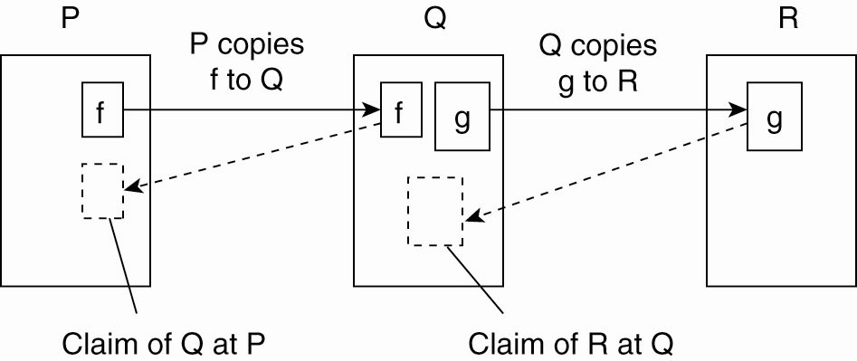
Secure Collaborative Storage
The principle of storage claims in the
Samsara peer-to-peer system

